Slide 1
DevOps Overview
SE489: DevOps Engineering

Slide 2
Outline
Why DevOps?
What is DevOps?
DevOps: The Three Way
DevOps Tools and Stages
DevOps Use Case

Slide 3
Why DevOps?

Slide 4
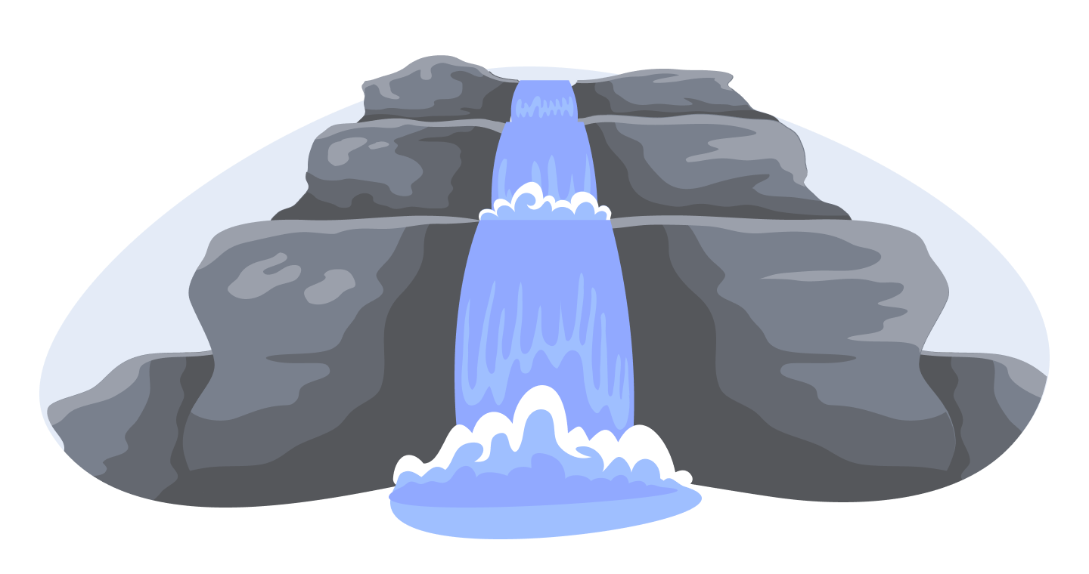
Waterfall Model
Distinct goals for each phase of Development
After each step is finished, there is no way to go back
Linear/Sequential

Slide 5
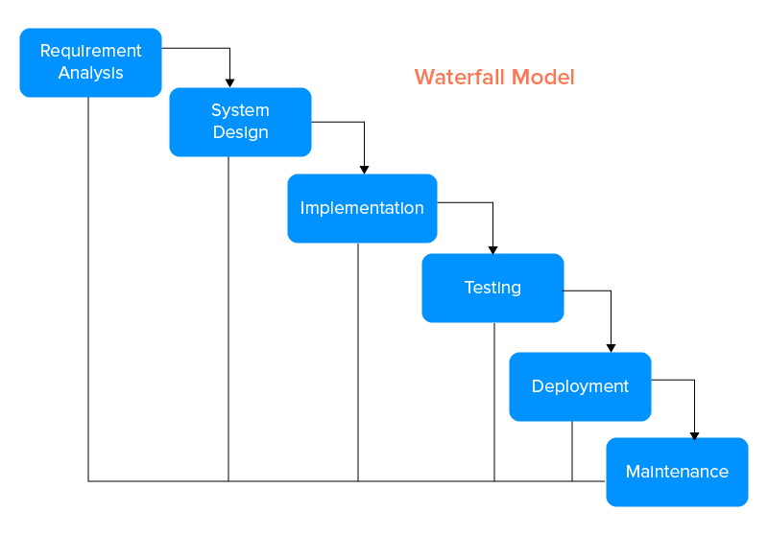
Waterfall Model

Slide 6
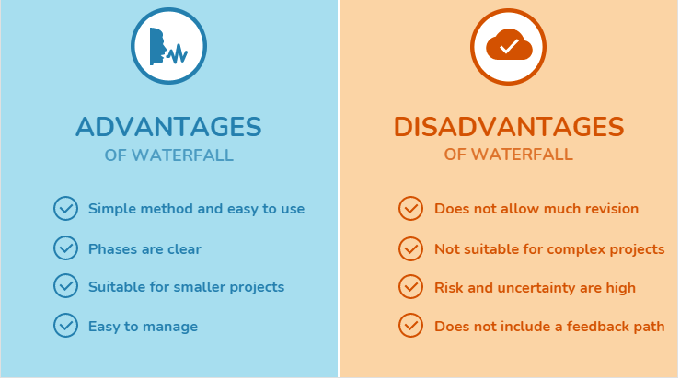
Limitations of Waterfall Model

Slide 7
Limitations of Waterfall Model
High amounts of risk and uncertainty
Not a good model fro complex and object-oriented projects
Not suitable for the projects where requirements are at moderate to hgih risk of changing
No working software is produced until late during the lifecycle
Once an application is in the testing stage, it is very difficult to go back and change something

Slide 8
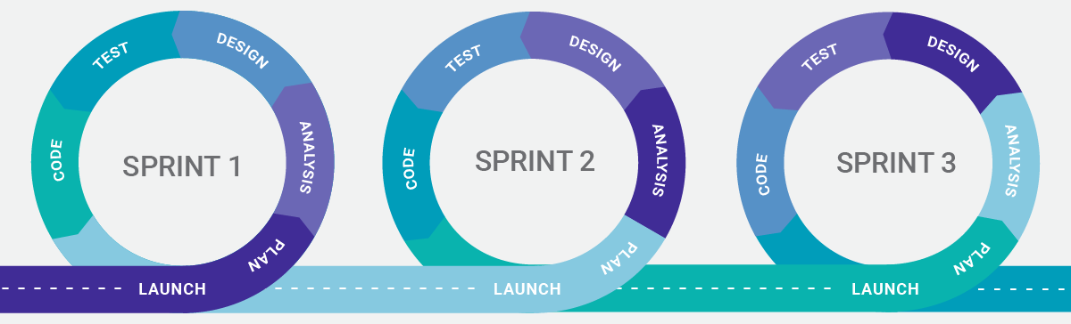
What is Agile Methodology?
Each project is broken up into several iterations/sprints
All iterations should be of the same time duration (between 2 to 8 weeks)
At the end of each iteration, a working product should be delivered

Slide 9
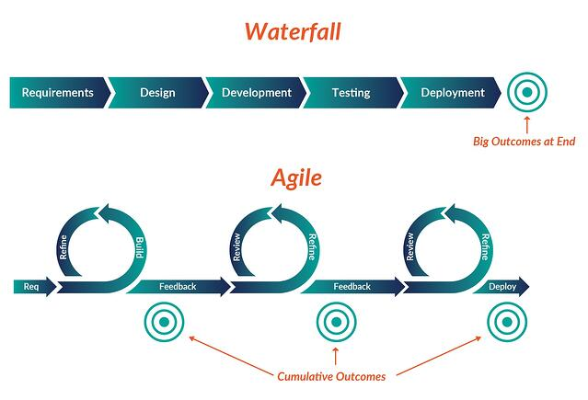
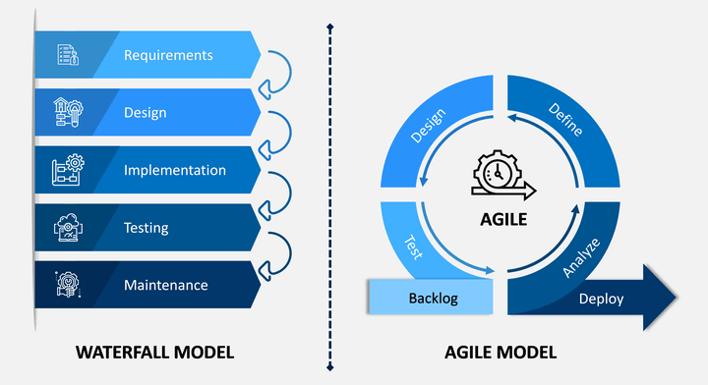
Waterfall vs Agile

Slide 10
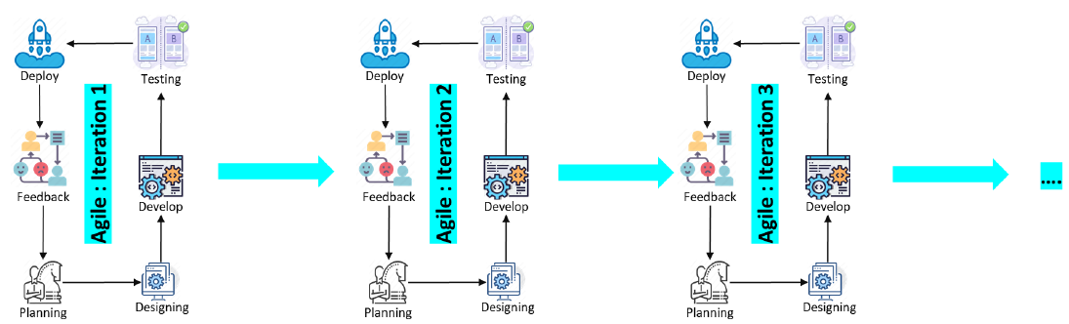
Agile Model
What makes a development method an agile one?
Breakdown the whole application to different sub-services
Incremental: small software releases, with rapid cycles
Cooperative: customer and developers working constantly together with close communication
Straightforward: the method itself is easy to learn and to modify, well documented
Adaptive: able to make last moment changes

Slide 11
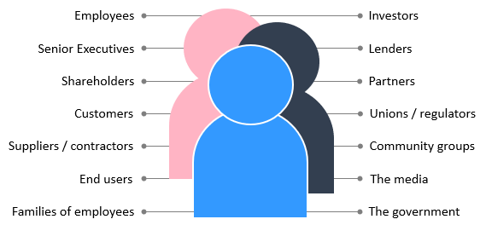
Limitations of Agile
Disadvantages:
Developer computer is used mainly for testing of those features
Test and production environment configuration mismatch
Usually not tested in production environment
Developers team and operations team are in silos
Continuous involvement of all the stakeholders.

Slide 12
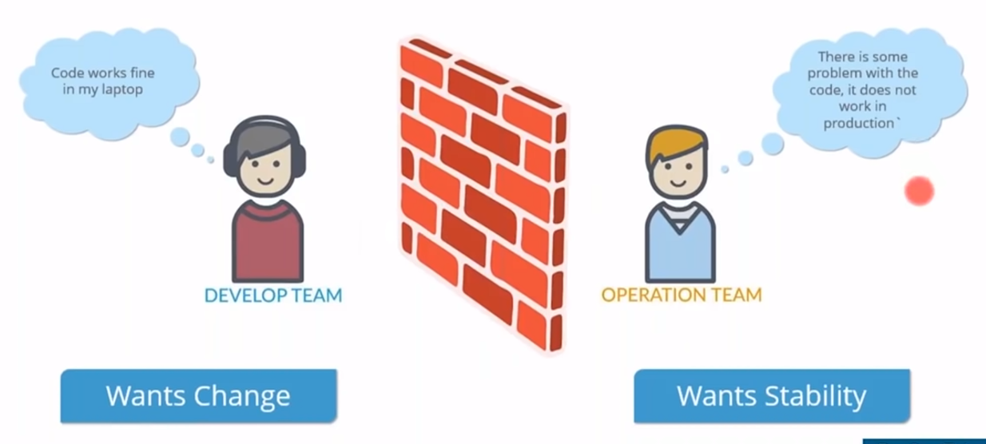
Limitations of Agile

Slide 13
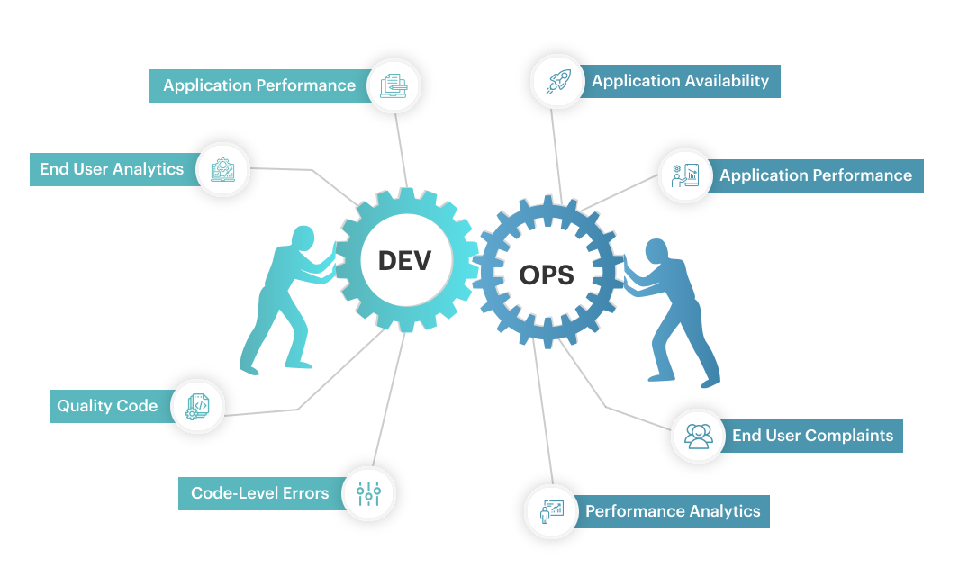
Solution is DevOps

Slide 14
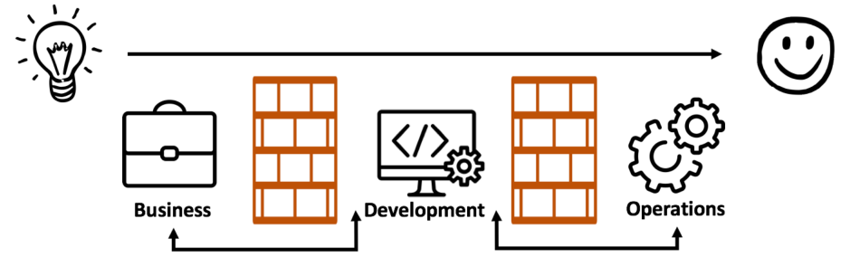
DevOps Transformation
Development wants rapid change
Operations wants stability and quality
DevOps helps achieve both objectives through creating and transforming shared culture, processes, and technology
Agile fixes this DevOps fixes this

Slide 15
Why DevOps?
DevOps enables us to simultaneously improve:
Organizational performance
Achieve the goals of all the various functional technology roles (e.g., Development, QA, IT Operations, Infosec)
Improve the human condition
DevOps shows us that when we have the right architecture, the right technical practices, and the right cultural norms:
Small teams of developers are able to quickly, safely, and independently develop, integrate, test, and deploy changes into production.

Slide 16
DevOps
High-performing organizations using DevOps practices were outperforming their non–high performing peers in the following areas:
Throughput metrics
Code and change deployments (thirty times more frequent)
Code and change deployment lead time (two hundred times faster)
Reliability metrics
Production deployments (sixty times higher change success rate)
Mean time to restore service (168 times faster)
Organizational performance metrics
Productivity, market share, and profitability goals (two times more likely to exceed)
Market capitalization growth (50% higher over three years)

Slide 17
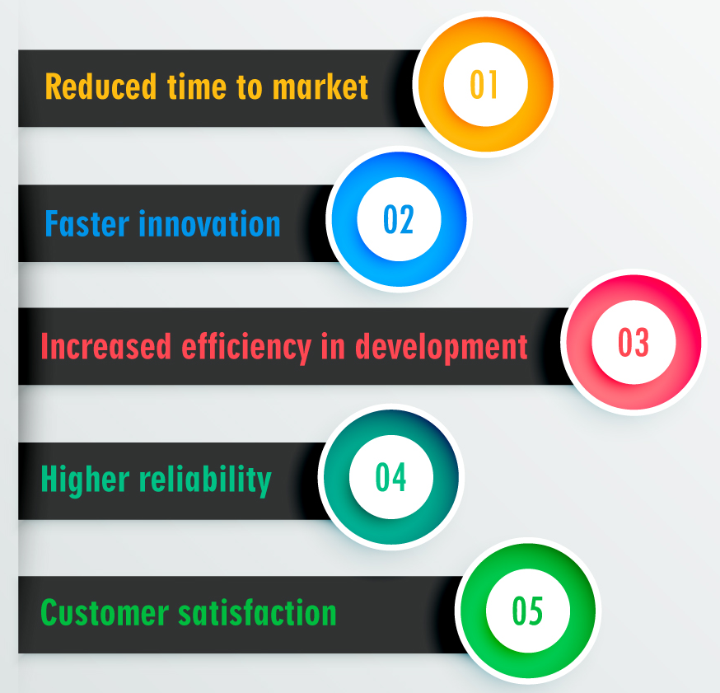
DevOps Benefits

Slide 18
What is DevOps?

Slide 19
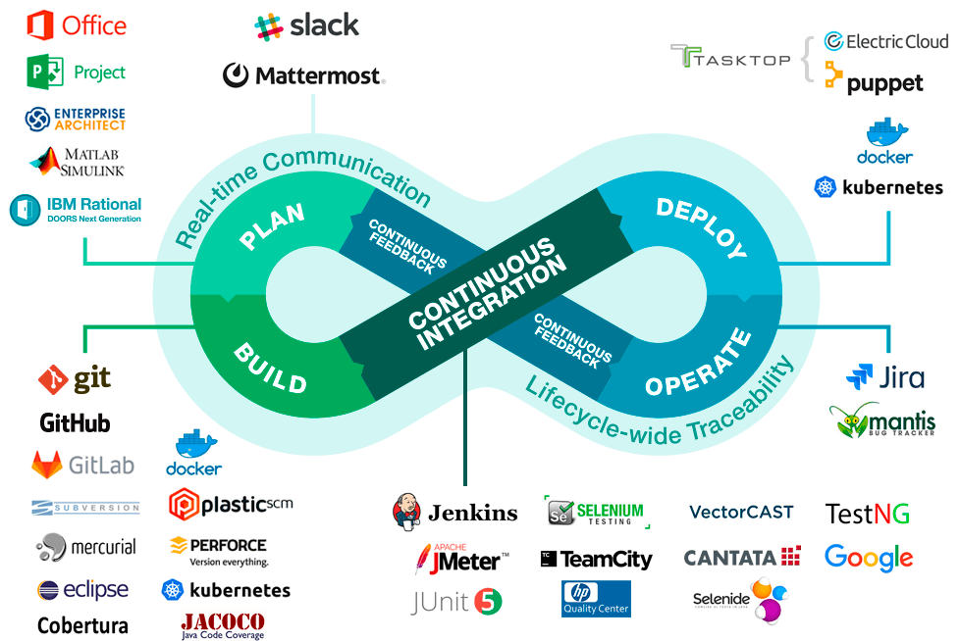
What is DevOps?

Slide 20
DevOps History
Concept of DevOps emerged out of a discussion between Andrew Clay and Patrick Debois in 2008.
Read more at: https://www.appknox.com/blog/history-of-devops
Devopsdays event:
a worldwide series of technical conferences
Topics: software development, IT infrastructure operations, and the intersection between them.
Started 2009
A series of event in this month (https://devopsdays.org/events)

Slide 21
DevOps Stats
2021 Global DevSecOps Survey by GitLab [src]
56% of ops teams are “fully” or mostly automated – up 10% from 2020.
~25% of respondents claimed to have full test automation – up 13% from 2020.
75% of teams are either using AI/ML or bots for test/code review, or they’re planning to – up 41% from 2020.
60% of developers are releasing code 2x faster than before – up
25% from (pre-pandemic) 2020.

Slide 22
DevOps Stats
Netflix:
1000s of daily production changes
10000s of Virtual instances
100,000s of customer interactions/sec
Billions of time-series metrics
100s of operation engineers
Amazon:
Deploys more than 20k releases / day
10s of apps

Slide 23
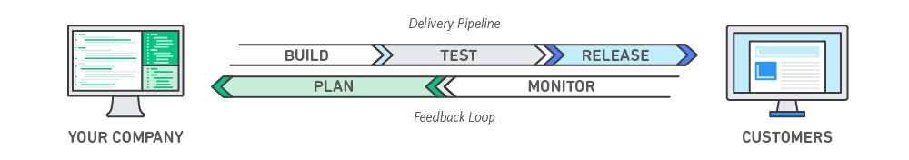
What is DevOps?
DevOps is a software development approach that unites the three crucial components
Development
Quality assurance
Operations.
It is a natural extension of Agile methodology that facilitates end-to-end responsibility, cross-functional components, and collaboration.
DevOps is a set of practices that help teams build, test, and deploy new software more efficiently and accelerate the bug elimination process.

Slide 24
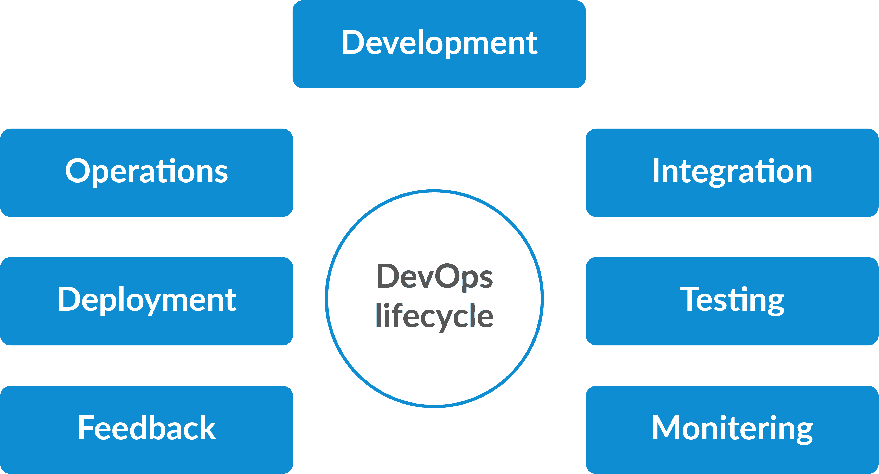
DevOps Lifecycle

Slide 25
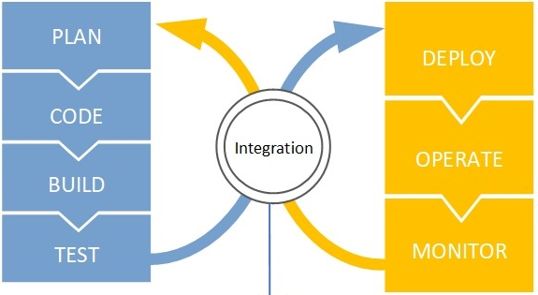
DevOps Lifecycle

Slide 26
DevOps Phases-Plan
Need to have a Vision -> goal for all participants
Idea -> Planning -> Strategy -> Success
What are the thing that should be in the agenda/mind:
customer, client,
software requirement,
enhancement request, bug fix, line-of-business,
features, idea
Break work down into smaller, manageable chunks for quicker deployments
Addresses
changes and evolutions according to a continuous improvement process and continuous feedback.
Requirements
Training on tools and metrics in order to have enough visibility of the project’s development.

Slide 27
DevOps Phases-Code
Here you mainly
write code
Use of plugins to
consistent code-styling
avoid common security flaws
Avoid code anti-patterns.
Several VCS for maintaining the
codes
designing infrastructure,
automating processes,
defining tests
implementing security

Slide 28
DevOps Phases-Build
Write code ->
Commit to the code repo
Create pull request
Code review: consistent code-styling , avoid common security flaws , Avoid code antipatterns.
Automated tests for possible bugs
Merge pull request

Slide 29
DevOps Phases-Test
A test can be:
Scripted (e.g. test case or automated test) or exploratory
scenario based testing
Executed manually or through automation
Linked to/cover one or more requirements
Like any other Jira issue type, it can be labeled, prioritized, assigned to components, and commented on
Types of tests:
unit tests,
integration tests,
functional tests,
end-to-end tests,
acceptance tests,
performance tests,
and smoke tests.

Slide 30
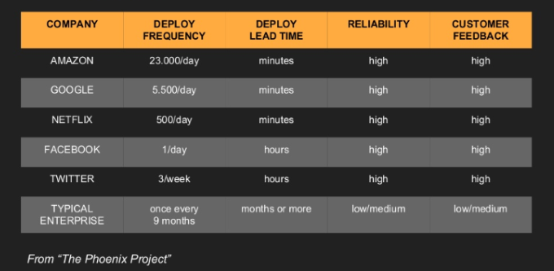
DevOps Phases-Release
Code successfully passes through all test phases (unit/integration/system tests)
Build is ready and can be released
Release can be made automated or manual

Slide 31
DevOps Phases-Deploy
You basically deploy the product on a production environment
Product is ready for
different deployment contexts
different deployment environments
different deployment platforms
If the release process for deployment to the production environment is also automated, it is referred to as continuous deployment.

Slide 32
DevOps Phases-Operate
The product live in production environment
Operations team relies on automated tools wherever possible for
configuration management
scaling
load balancing

Slide 33
DevOps Phases-Monitor
Monitor the environments
Capturing metrics describing the software’s performance.
Collects customers’ feedback on their experiences
Analytics on customer behavior
Performance, errors and more
Monitor the DevOps pipeline itself

Slide 34
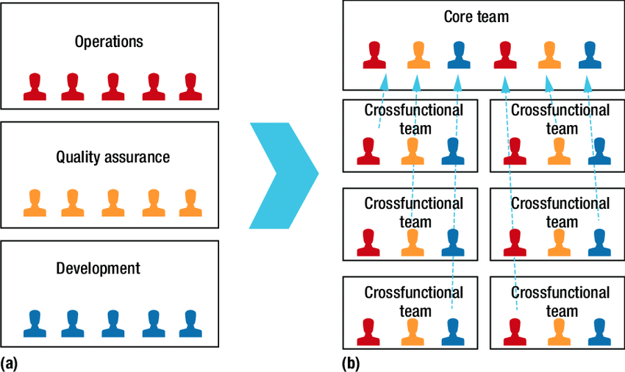
DevOps Goals
Break down silos
Create cross-functional teams
Better IT alignment and business responsiveness
Faster, smaller, more frequent releases
Improved
Time to market
Quality of code, products and services
Productivity
Customer satisfaction
Employee satisfaction
Less waste and fewer defects
Lower long‐term costs

Slide 35
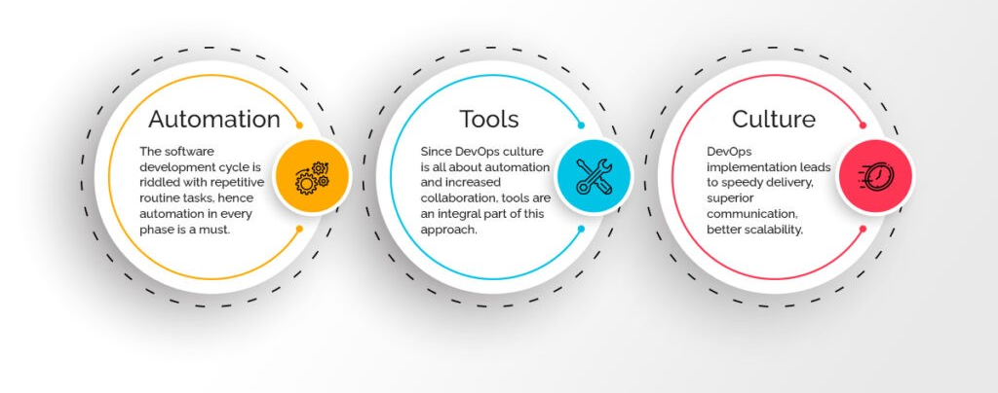
Core Fundamentals of DevOps

Slide 36
Core Fundamentals of DevOps
Automation:
It is the first step in making your organization DevOps-rich.
By creating a more efficient workflow, DevOps helps in keeping everything monitored and reported.
Tools:
DevOps culture is all about automation and increased collaboration
Culture:
DevOps implementation leads to speedy delivery, superior communication, better scalability, process automation, and a better environment for technical stability.
DevOps culture thus results in streamlining the software development life cycle at every stage.

Slide 37
Agile, Cont. Delivery, and the Three Way
The Manufacturing Value Stream
The sequence of activities an organization undertakes to deliver upon a customer request.
The Technology Value Stream
The process required to convert a business hypothesis into a technology enabled service that delivers value to the customer.
Focus on Deployment Lead Time
From checking a change into version control to successfully running in production, providing value to the customer and generating useful feedback and telemetry.
Observing (%C/A) As a Measure of Rework
Asking downstream customers what percentage of the time they receive work that is ‘usable as is.’

Slide 38
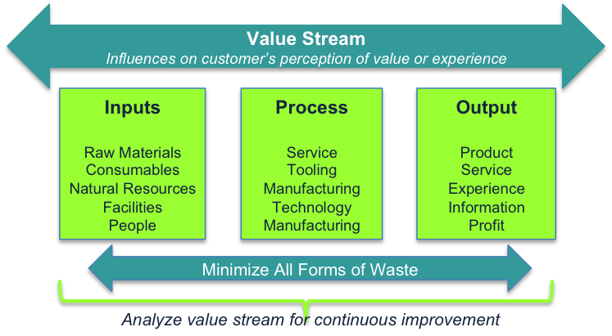
The Manufacturing Value Stream
“the sequence of activities an organization undertakes to deliver upon a customer request,” or
“the sequence of activities required to design, produce, and deliver a good or service to a customer, including the dual flows of information and material.

Slide 39
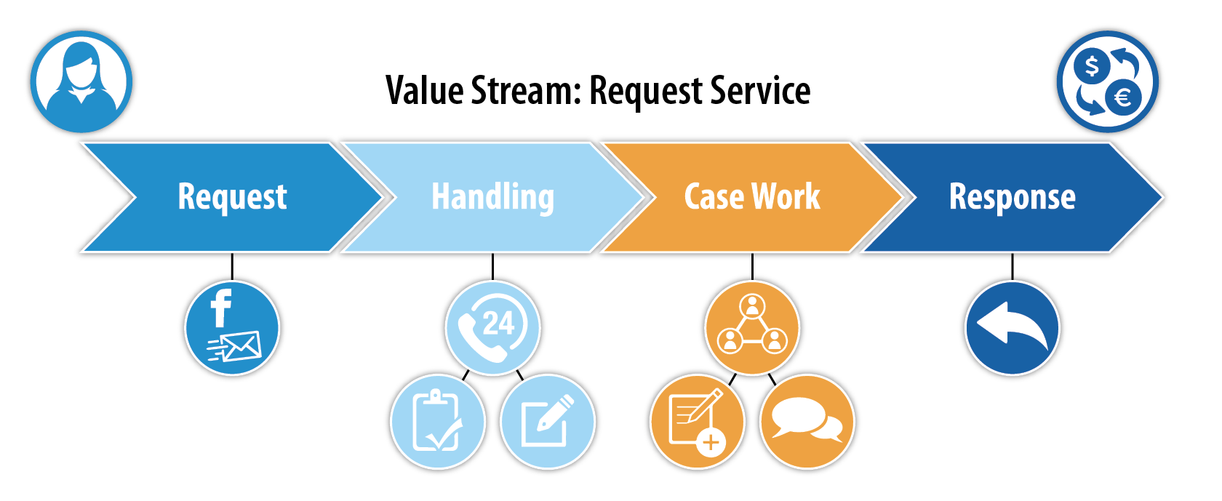
The Technology Value Stream
The same principles and patterns that enable the fast flow of work in physical processes are equally applicable to technology work (and, for that matter, for all knowledge work).
In DevOps, we typically define our technology value stream as the process required to convert a business hypothesis into a technology enabled service that delivers value to the customer

Slide 40
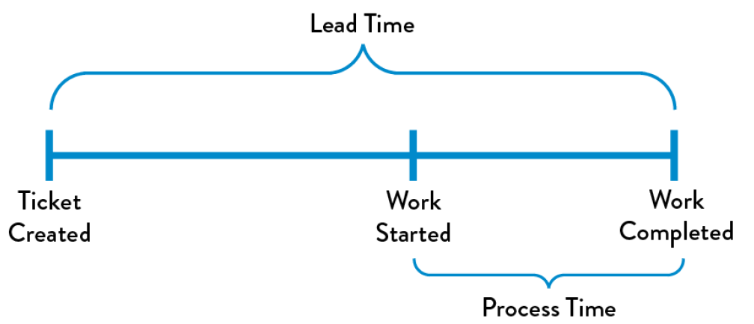
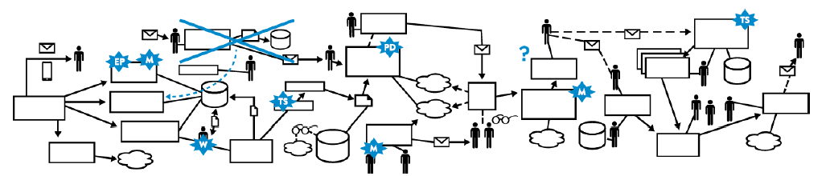
Focus on Deployment Lead Time
Focus on deployment lead time, a subset of the value stream.
This value stream begins when any engineer in the value stream (which includes Development, QA, IT Operations, and Infosec) checks a change into version control and ends when that change is successfully running in production, providing value to the customer and generating useful feedback and telemetry

Slide 41
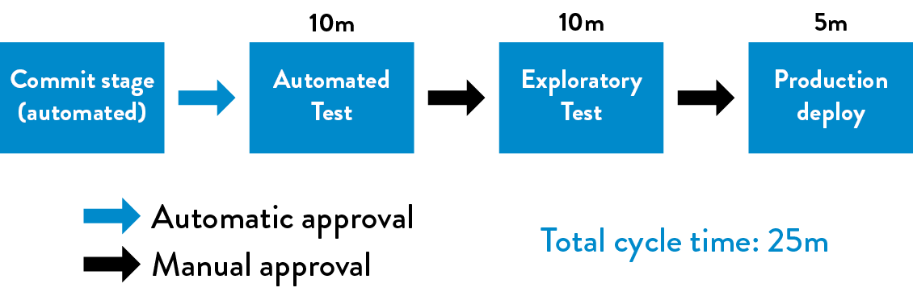
A Technology Value Stream
Our DevOps Ideal: Deployment Lead Times of Minutes
Developers receive fast, constant feedback on their work, which enables them to quickly and independently implement, integrate, and validate their code, and have the code deployed into the production environment.
Continually checking small code changes into our version control repository, performing automated and exploratory testing against it, and deploying it into production.

Slide 42
Observing (%C/A) As a Measure of Rework
This metric reflects the quality of the output of each step in our value stream.
(%C/A) metric can be obtained by asking downstream customers what percentage of the time they receive work that is ‘usable as is,’ meaning that they can do their work without having to correct the information that was provided, add missing information that should have been supplied, or clarify information that should have and could have been clearer.

Slide 43
DevOps: The Three Way

Slide 44
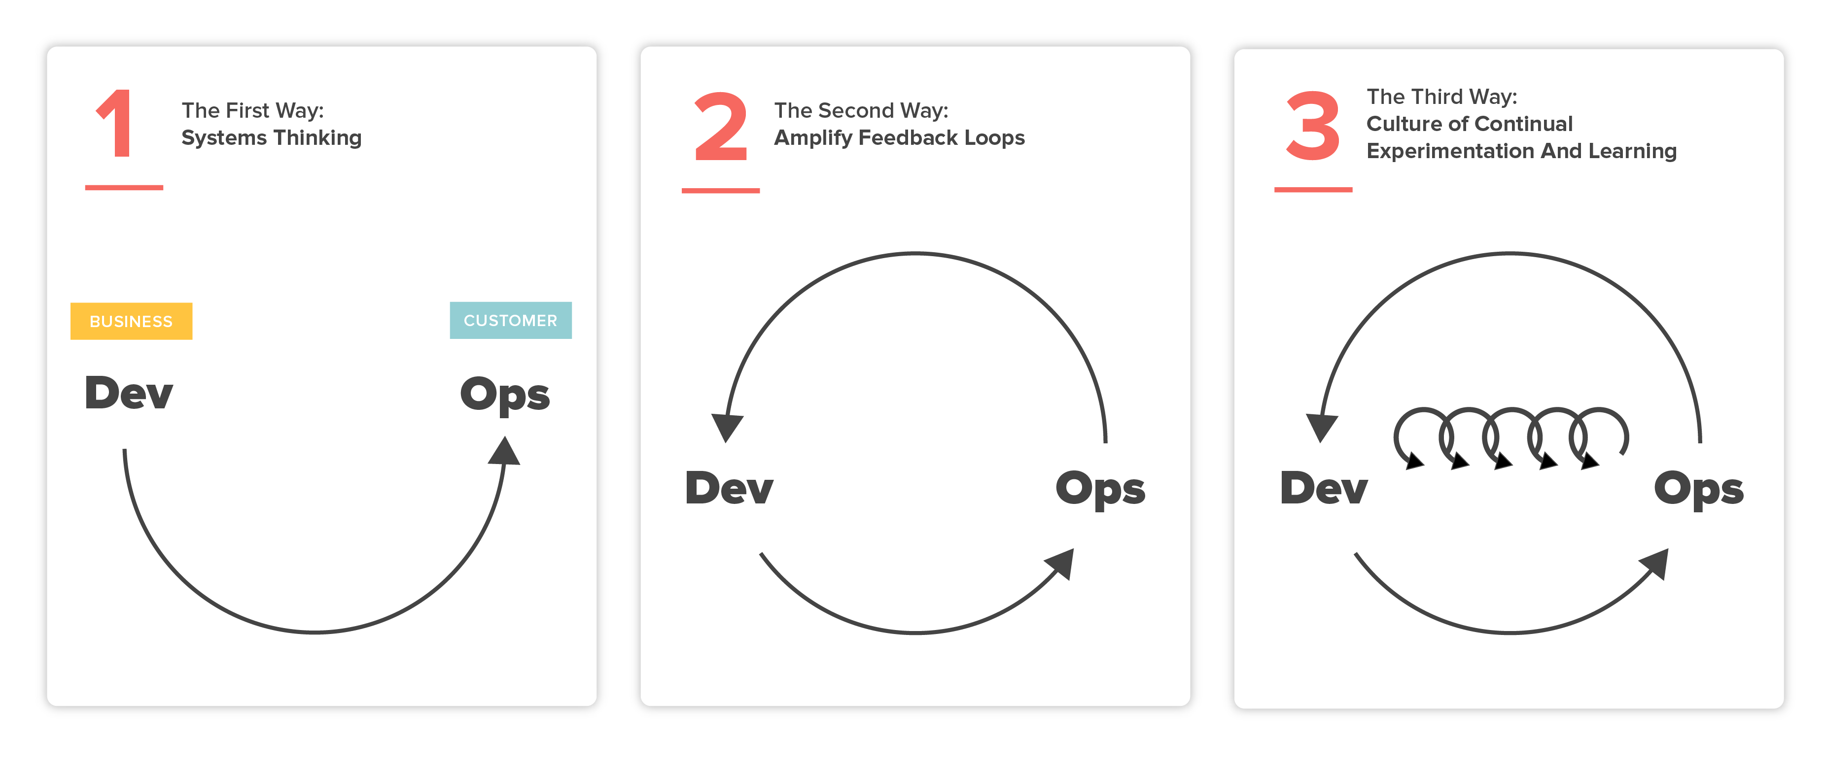
DevOps: The Three Way

Slide 45

The First Way: System Thinking
Technical Value Stream: Optimizing the process of delivering changes to the software.
It starts from the point where demand for a change or new feature is identified, through development, into operations where the value associated with the change is delivered to the customer.
It takes a complex systems view and emphasizes the optimization of the whole process rather than the individual parts.

Slide 46
The First Way: System Thinking
Reducing batch sizes and intervals of work, and by building quality in, preventing defects from being passed to downstream work centers.
Make our Work Visible
To help us see where work is flowing well and where work is queued or stalled, we need to make our work as visible as possible.
Limit Work In Progress (WIP)
This high level of effort discourages frequent disruptions.
Reduce Batch Sizes
Large batch sizes result in skyrocketing levels of WIP and high levels of variability in flow.
Reduce the Number of Handoffs
Even under the best circumstances, some knowledge is inevitably lost with each handoff.
Continually Identify and Elevate our Constraints
Any improvement not made at that constraint is an illusion.
Eliminate Hardship and Waste in the Value Stream
Reduce hardship and drudgery in our daily work through continual learning in order to achieve the organization’s goals.

Slide 47
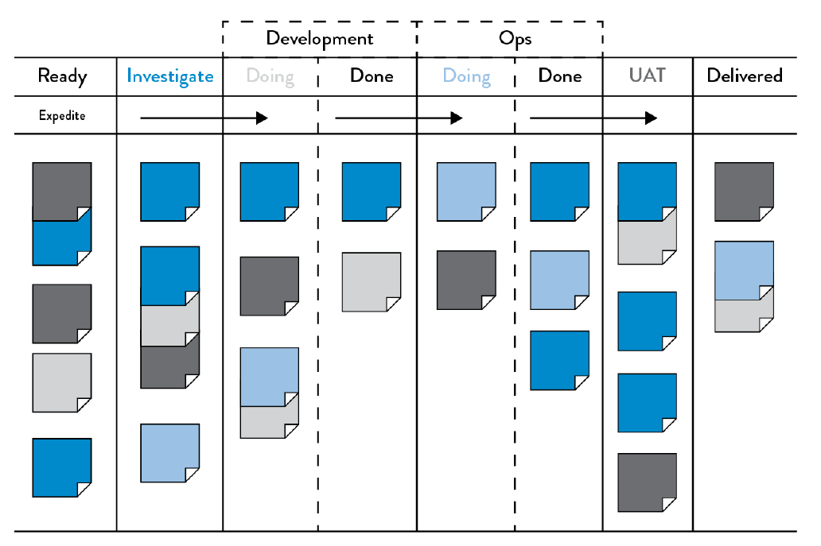
Make our Work Visible
A significant difference between technology and manufacturing value streams is that our work is invisible.
Unlike physical processes, in the technology value stream we cannot easily see where flow is being impeded or when work is piling up in front of constrained work centers.
Transferring work between work centers is usually highly visible and slow because inventory must be physically moved.

Slide 48
Limit Work In Progress (WIP)
In technology, our work is usually far more dynamic—this is especially the case in shared services, where teams must satisfy the demands of many different stakeholders.
As a result, daily work becomes dominated by the priority du jour, often with requests for urgent work coming in through every communication mechanism possible, including ticketing systems, outage calls, emails, phone calls, chat rooms, and management escalations.

Slide 49
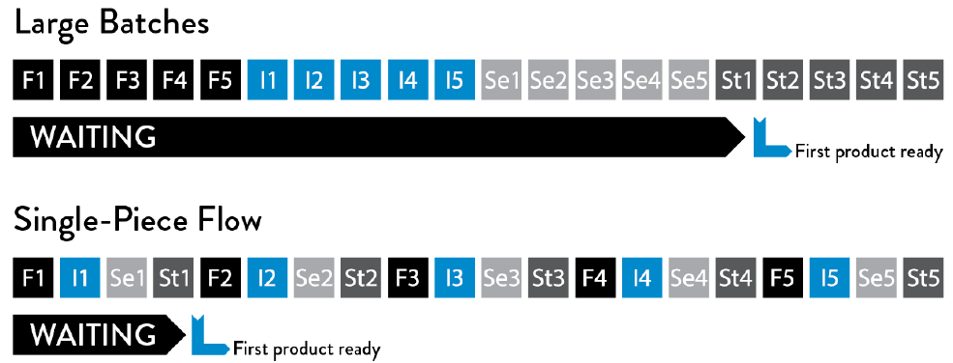
Reduce Batch Sizes
Another key component to creating smooth and fast flow is performing work in small batch sizes.
Prior to the Lean manufacturing revolution, it was common practice to manufacture in large batch sizes (or lot sizes).
For example, producing large car body panels requires setting large and heavy dies onto metal stamping machines, a process that could take days.

Slide 50
Reduce the Number of Handoffs
Each time the work passes from team to team, we require all sorts of communication: requesting, specifying, signaling, coordinating, and often prioritizing, scheduling, deconflicting, testing, and verifying.
This may require using different ticketing or project management systems; writing technical specification documents; communicating via meetings, emails, or phone calls; and using file system shares, FTP servers, and Wiki pages.

Slide 51
Continually Identify and Elevate our Constraints
“In any value stream, there is always a direction of flow, and there is always one and only constraint; any improvement not made at that constraint is an illusion.”
We progress from deployment lead times measured in months or quarters to lead times measured in minutes, the constraint usually follows this progression:
Environment creation
Code deployment
Test setup and run
Overly tight architecture

Slide 52
Eliminate Hardship and Waste in the Value Stream
Waste constituted the largest threat to business viability—the commonly used definition in Lean is “the use of any material or resource beyond what the customer requires and is willing to pay for.”
There are seven major types of manufacturing waste: inventory, overproduction, extra processing, transportation, waiting, motion, and defects.
More modern interpretations of Lean have noted that “eliminating waste” can have a demeaning and dehumanizing context; instead, the goal is reframed to reduce hardship and drudgery in our daily work through continual learning in order to achieve the organization’s goals.

Slide 53
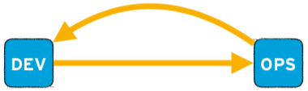
The Second Way: The Feedback Principle
Creating feedback loops from operations back to development.
It's about amplifying this feedback so the software and the process to change the software is continuously improved.
The goal is to understand feedback, respond to it and implement improvements based on it. By doing so, shorter (and therefore valuable) feedback loops are used to make necessary changes on a continuous basis.

Slide 54
The Second Way: The Principles of Feedback
Working Safely Within Complex Systems
Design a safe system of work, where we can perform work without fear.
See Problems as They Occur
Increase information flow in our system sooner, faster, cheaper, and with clarity between cause and effect.
Swarm and Solve Problems to Build New Knowledge
Converting inevitable up-front ignorance into knowledge.
Keep Pushing Quality Closer to the Source
Having developers share responsibility for the quality of the systems.
Enable Optimizing for Downstream Work Centers
Our most important customer is our next step downstream.

Slide 55
Working Safely Within Complex Systems
One of the defining characteristics of a complex system is that it defies any single person’s ability to see the system as a whole and understand how all the pieces fit together.
Complex systems typically have a high degree of interconnectedness of tightly coupled components, and system-level behavior cannot be explained merely in terms of the behavior of the system components.
Because failure is inherent and inevitable in complex systems, we must design a safe system of work, whether in manufacturing or technology, where we can perform work without fear, confident that any errors will be detected quickly, long before they cause catastrophic outcomes, such as worker injury, product defects, or negative customer impact.

Slide 56
See Problems as They Occur
In a safe system of work, we must constantly test our design and operating assumptions.
Our goal is to increase information flow in our system from as many areas as possible, sooner, faster, cheaper, and with as much clarity between cause and effect as possible.
The more assumptions we can invalidate, the faster we can find and fix problems, increasing our resilience, agility, and ability to learn and innovate. We do this by creating feedback and feedforward loops into our system of work.

Slide 57
Swarm and Solve Problems to Build New Knowledge
Obviously, it is not sufficient to merely detect when the unexpected occurs.
When problems occur, we must swarm them, mobilizing whoever is required to solve the problem.
The goal of swarming is to contain problems before they have a chance to spread, and to diagnose and treat the problem so that it cannot recur. “In doing so,” he says, “they build ever-deeper knowledge about how to manage the systems for doing our work, converting inevitable up-front ignorance into knowledge.”

Slide 58
Keep Pushing Quality Closer to the Source
We may inadvertently perpetuate unsafe systems of work due to the way we respond to accidents and incidents.
In complex systems, adding more inspection steps and approval processes actually increases the likelihood of future failures.
The effectiveness of approval processes decreases as we push decision making further away from where the work is performed. Doing so not only lowers the quality of decisions but also increases our cycle time, thus decreasing. Having developers share responsibility for the quality of the systems they build not only improves outcomes but also accelerates learning.

Slide 59
Enable Optimizing for Downstream Work Centers
Lean defines two types of customers that we must design for: the external customer (who most likely pays for the service we are delivering) and the internal customer (who receives and processes the work immediately after us).
According to Lean, our most important customer is our next step downstream. Optimizing our work for them requires that we have empathy for their problems in order to better identify the design problems that prevent fast and smooth flow.

Slide 60
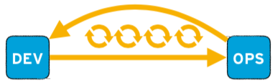
The Third Way: Continuous Learning and Experimentation
Creating a culture of experimentation and learning and ensuring that the processes for changing the software minimize the cost of failure so that failure is accepted as an integral feature of experimentation.
This means that the entire team can benefit from their successes and failures and implement improvements based on "real" results.
Ensures that an organization and its teams remain constantly able to adapt and act efficiently and independently of the environment.

Slide 61
The Third Way: Continuous Learning and Experimentation
Enabling Organizational Learning and a Safety Culture
When accidents and failures occur, instead of looking for human error, we look for how we can redesign the system to prevent the accident from happening again.
Institutionalize the Improvement of Daily Work
Even more important than daily work is the improvement of daily work.
Transform Local Discoveries into Global Improvements
Convert individual expertise into artifacts that the rest of the organization can use.
Inject Resilience Patterns into Daily work
High performers achieve the same results (or better) by improving daily operations, continually introducing tension to elevate performance.
Leaders Reinforce a Learning Culture
Create the conditions so their team can discover greatness in their daily work.

Slide 62
Enabling Organizational Learning and a Safety Culture
When we work within a complex system, by definition it is impossible for us to perfectly predict all the outcomes for any action we take.
This is what contributes to unexpected, or even catastrophic, outcomes and accidents in our daily work, even when we take precautions and work carefully.
Dr. Sidney Dekker, who codified some of the key elements of safety culture and coined the term just culture, wrote, “Responses to incidents and accidents that are seen as unjust can impede safety investigations, promote fear rather than mindfulness in people who do safety-critical work, make organizations more bureaucratic rather than more careful, and cultivate professional secrecy, evasion, and self-protection.”

Slide 63
Institutionalize the Improvement of Daily Work
Teams are often not able or not willing to improve the processes they operate within.
The result is not only that they continue to suffer from their current problems, but their suffering also grows worse over time.
Mike Rother observed in Toyota Kata that in the absence of improvements, processes don’t stay the same—due to chaos and entropy, processes actually degrade over time.

Slide 64
Transform Local Discoveries into Global Improvements
When new learnings are discovered locally, there must also be some mechanism to enable the rest of the organization to use and benefit from that knowledge.
In other words, when teams or individuals have experiences that create expertise, our goal is to convert that tacit knowledge (i.e., knowledge that is difficult to transfer to another person by means of writing it down or verbalizing) into explicit, codified knowledge, which becomes someone else’s expertise through practice.

Slide 65
Inject Resilience Patterns into Daily work
Lower performing manufacturing organizations buffer themselves from disruptions in many ways—in other words, they bulk up or add flab.
For instance, to reduce the risk of a work center being idle (due to inventory arriving late, inventory that had to be scrapped, etc.), managers may choose to stockpile more inventory at each work center. However, that inventory buffer also increases WIP, which has all sorts of undesired outcomes, as previously discussed. Similarly, to reduce the risk of a work center going down due to machinery failure, managers may increase capacity by buying more capital equipment, hiring more people, or even increasing floor space. All these options increase costs

Slide 66
Leaders Reinforce a Learning Culture
Traditionally, leaders were expected to be responsible for setting objectives, allocating resources for achieving those objectives, and establishing the right combination of incentives.
Leaders also establish the emotional tone for the organizations they lead. In other words, leaders lead by “making all the right decisions.” However, there is significant evidence that shows greatness is not achieved by leaders making all the right decisions—instead, the leader’s role is to create the conditions so their team can discover greatness in their daily work. In other words, creating greatness requires both leaders and workers, each of whom are mutually dependent upon each other.

Slide 67
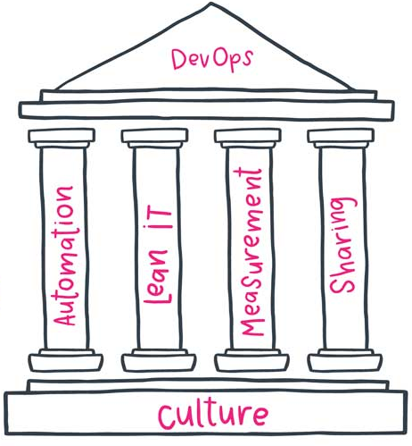
DevOps CALMS Framework
CALMS Framework
Assess and measure progress on your DevOps journey
Culture
Embraces change, seeking feedback in order to improve
Automation
The everything-as-code mindset is at the heart of DevOps
Lean (IT)
5 key principles of Lean
Measurement
“what gets measured gets done”
Sharing
Focus on breaking down silos between departments and sharing knowledge and best practice.

Slide 68
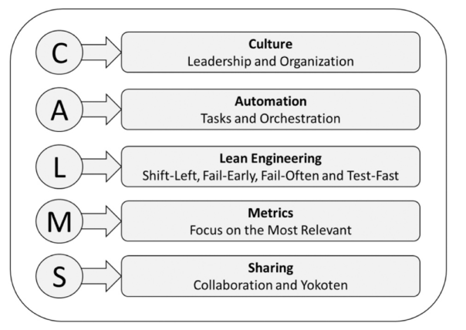
CALMS Framework

Slide 69
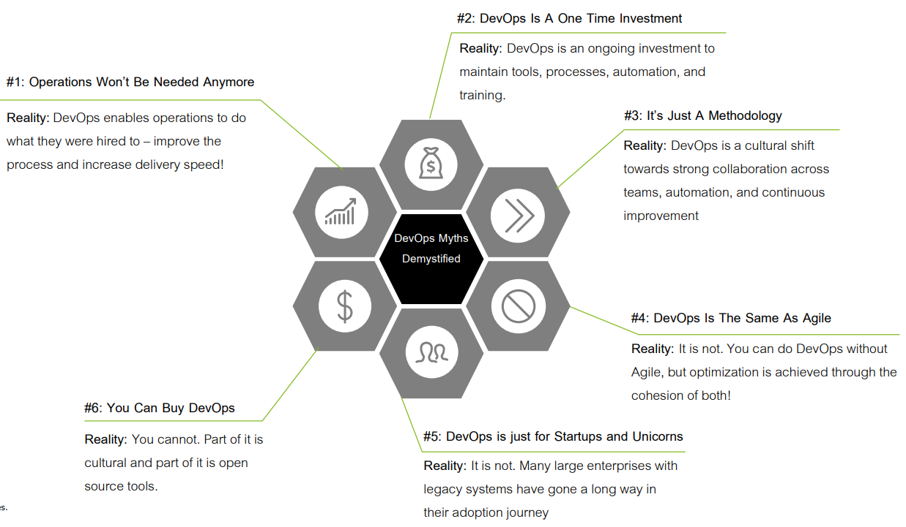
DevOps – Myths vs Reality

Slide 70
DevOps Tools and Stages

Slide 71
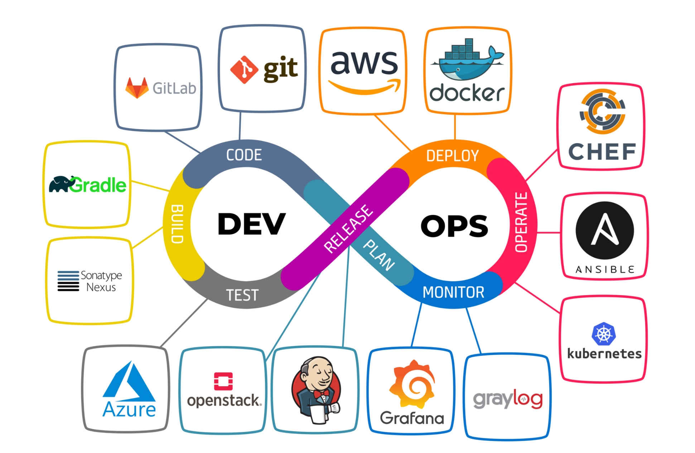
DevOps Tools

Slide 72
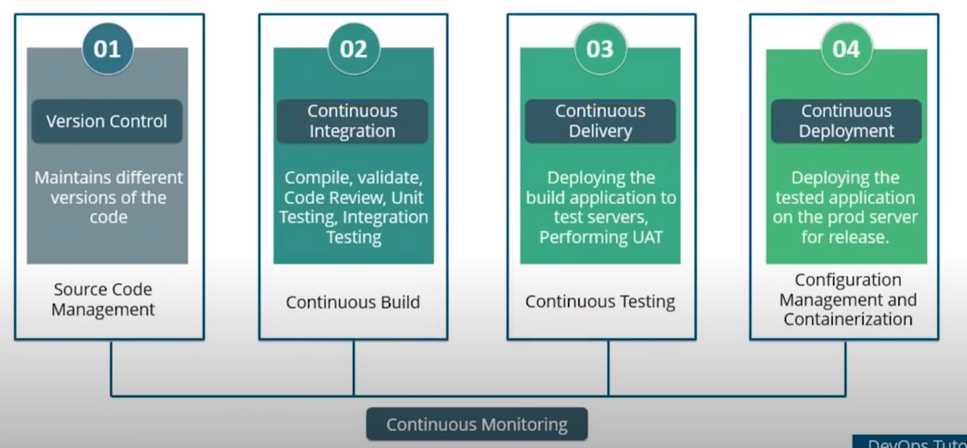
DevOps Stages

Slide 73
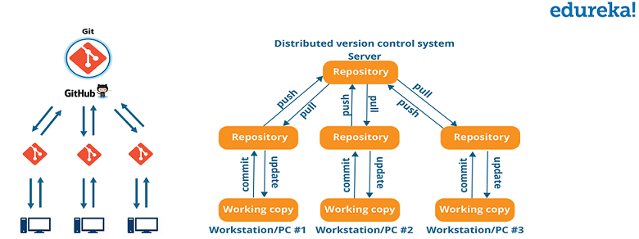
Version Control (Continuous Development)
This is the phase that involves ‘planning‘ and ‘coding‘ of the software.
The vision of the project is decided during the planning phase and the developers begin developing the code for the application.

Slide 74
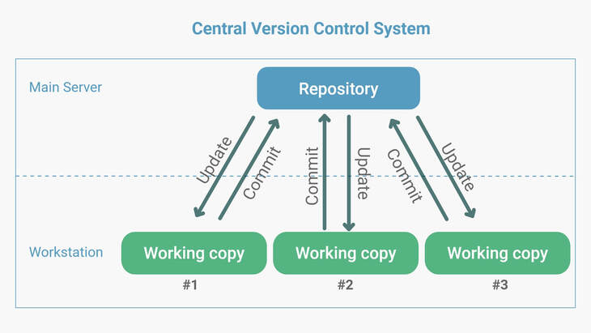
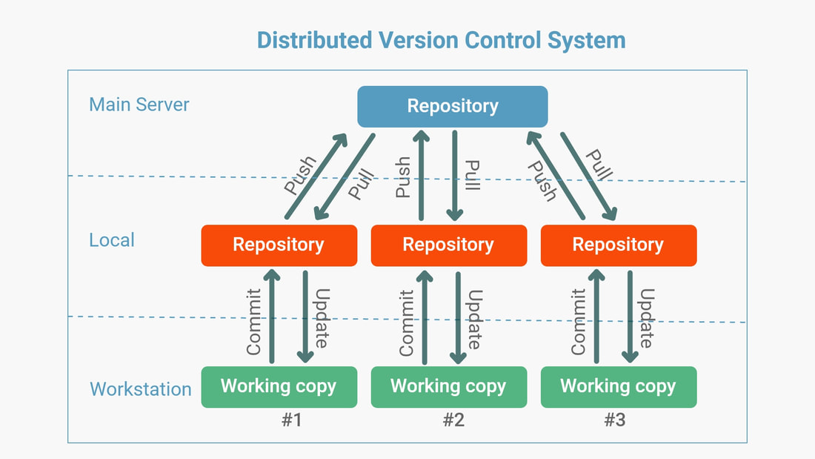
Source Code Management
The management of changes to documents, computer programs, large websites and other collection of information

Slide 75
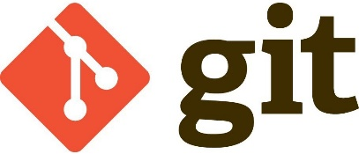
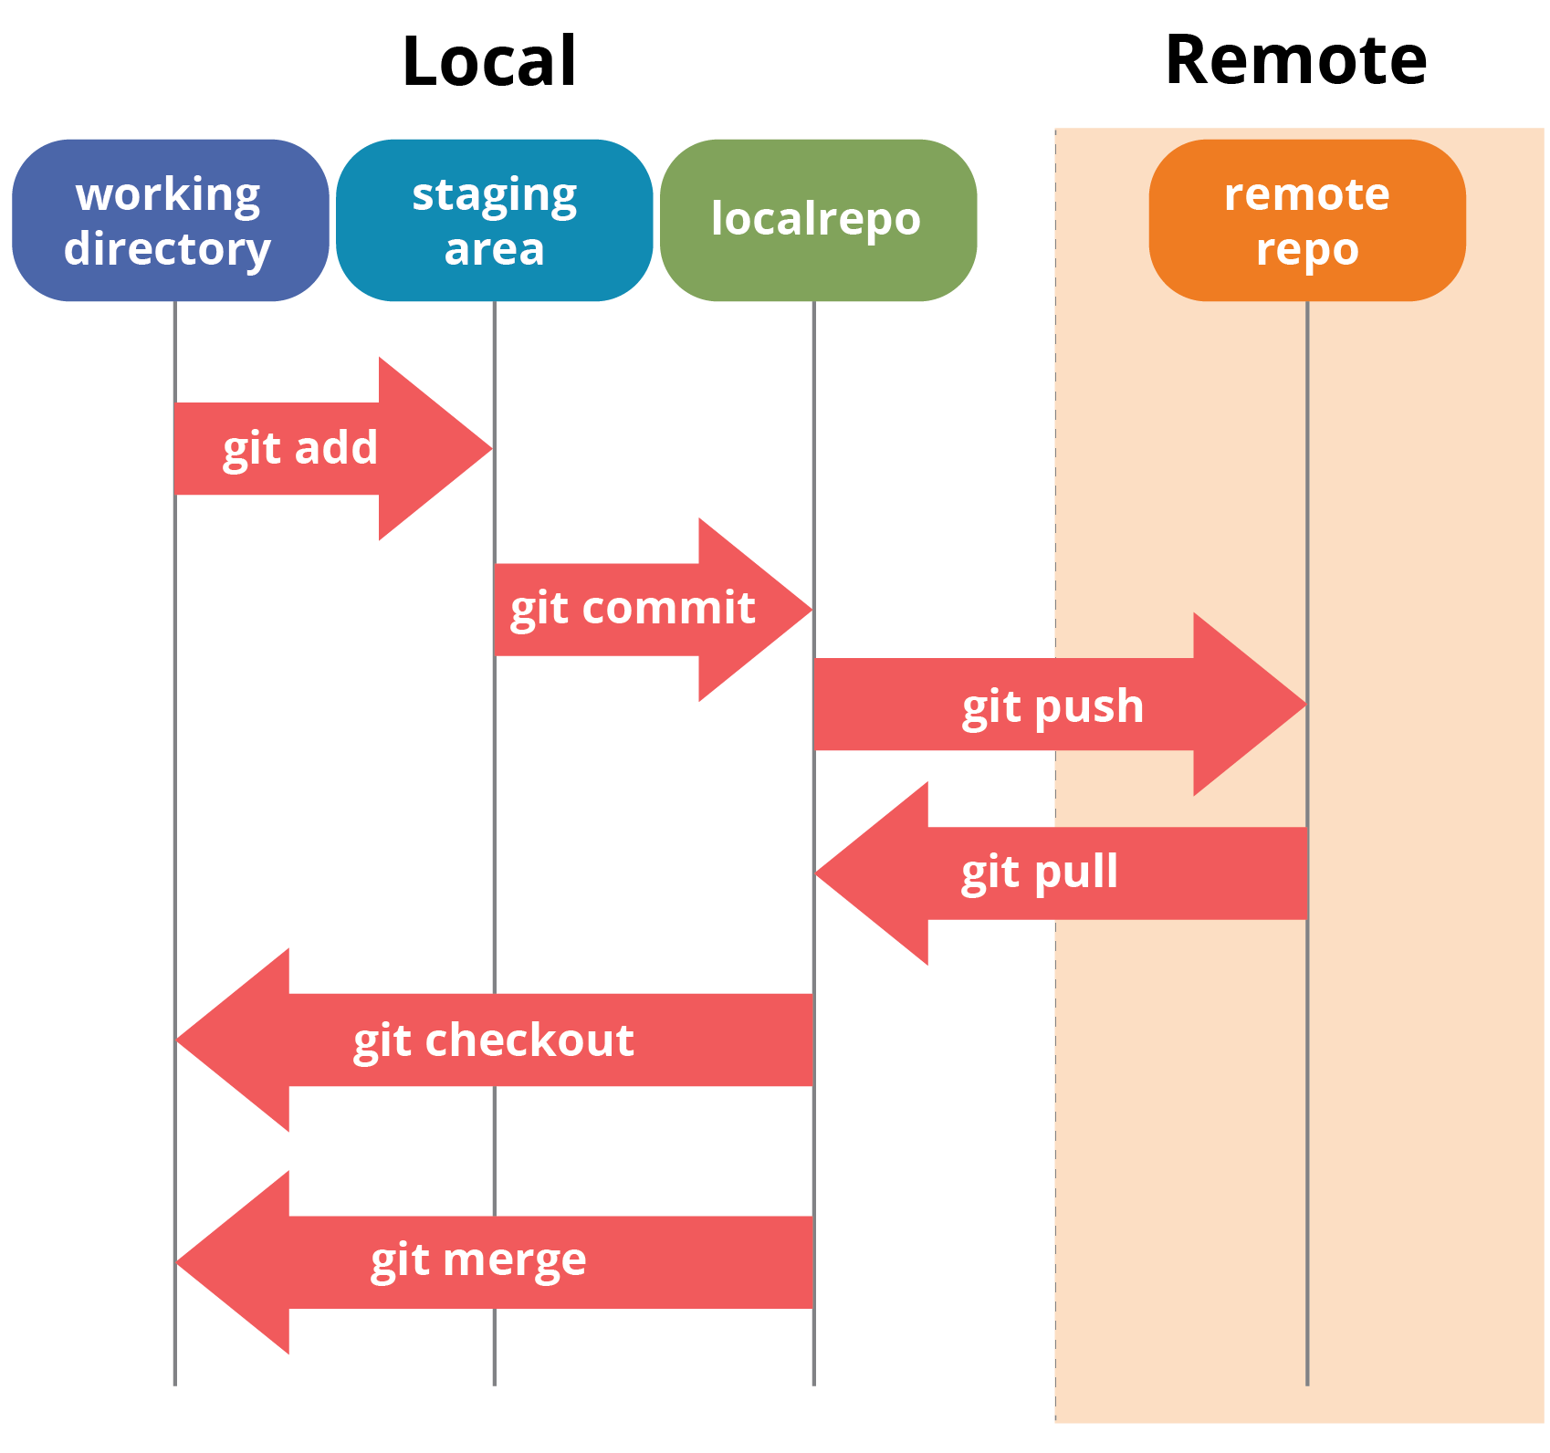
Source Code Management
Git is a Distributed Version Control tool that supports distributed non-linear workflows by providing data assurance for developing quality software

Slide 76
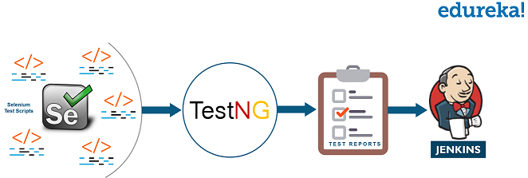
Continuous Testing
This is the stage where the developed software is continuously tested for bugs.
For Continuous testing, automation testing tools like Selenium, TestNG, JUnit, etc. are used.

Slide 77
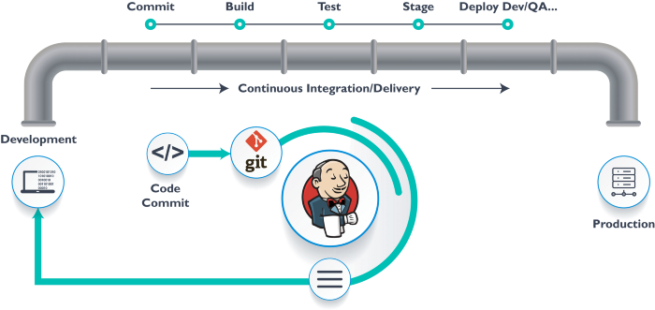
Continuous Integration
This stage is the heart of the entire DevOps life cycle.
It is a software development practice in which the developers require to commit changes to the source code more frequently.
This may be on a daily or a weekly basis.

Slide 78
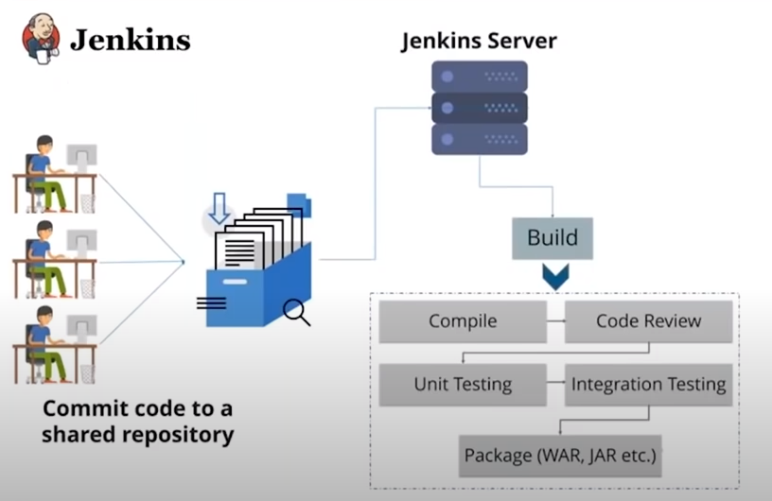
Continuous Integration

Slide 79
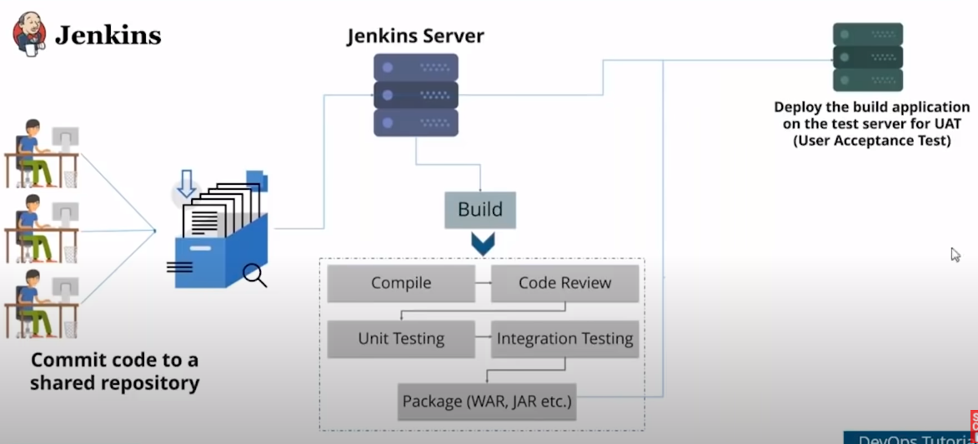
Continuous Delivery

Slide 80
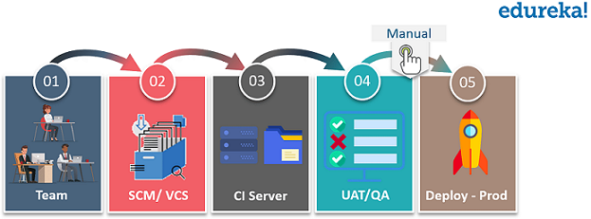
Continuous Deployment
This is the stage where the code is deployed to the production servers.
It is also important to ensure that the code is correctly deployed on all the servers.

Slide 81
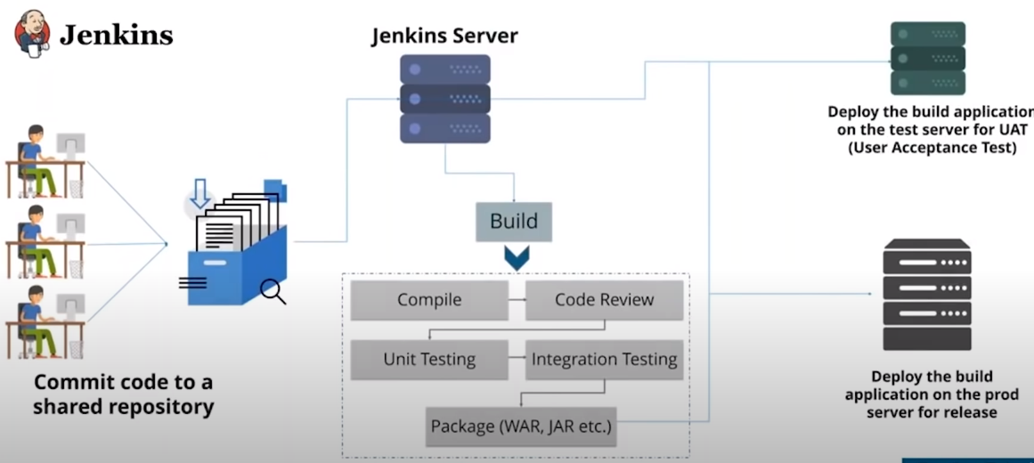
Continuous Deployment

Slide 82
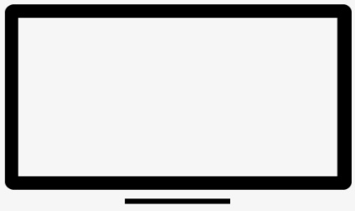
Configuration Management
DEV
Configuration Management is the practice of handling changes systematically so that a system maintains its integrity over time
{ }
TEST
{ }
Configuration Management (CM) ensures that the current design and build state of the system is known, good and trusted
Code for Infrastructure
PROD
Provisioning of Dev, Test, and Prod environment
{ }
It does not rely on the tacit knowledge of the development team

Slide 83
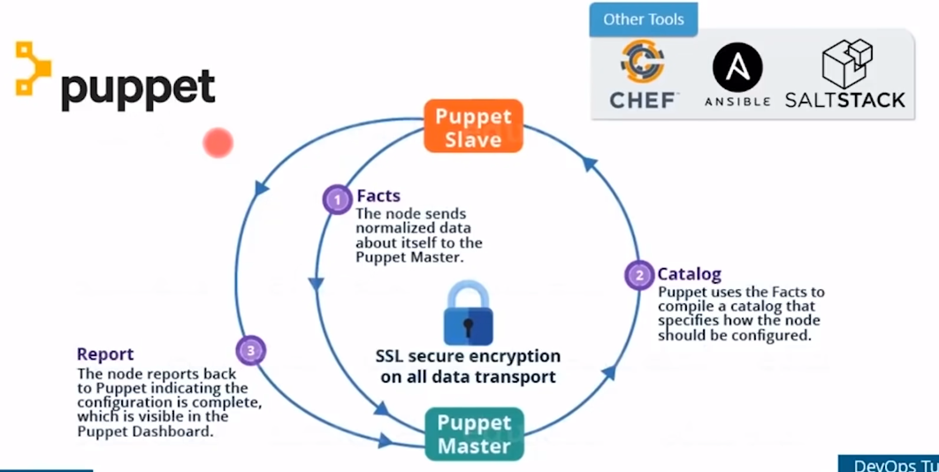
Configuration Management

Slide 84
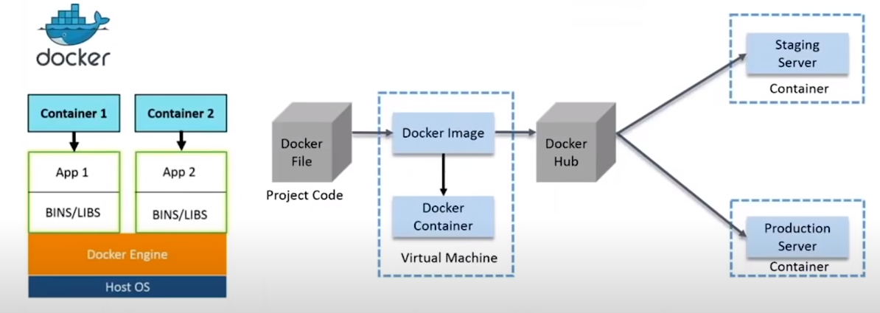
Containerization

Slide 85
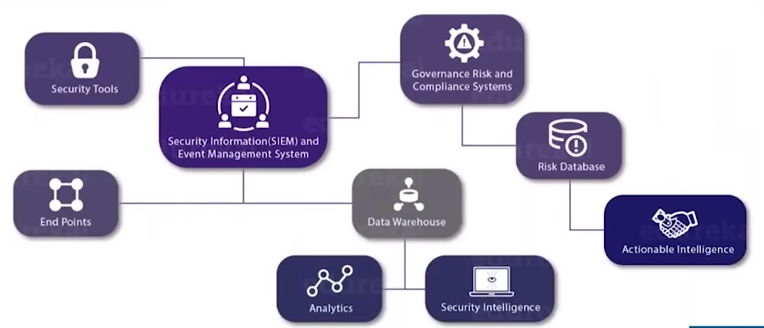
Continuous Monitoring
Continuous Monitoring is all about the ability of an organization to detect, report, respond, contain, and mitigate the attacks that occur, in its infrastructure

Slide 86
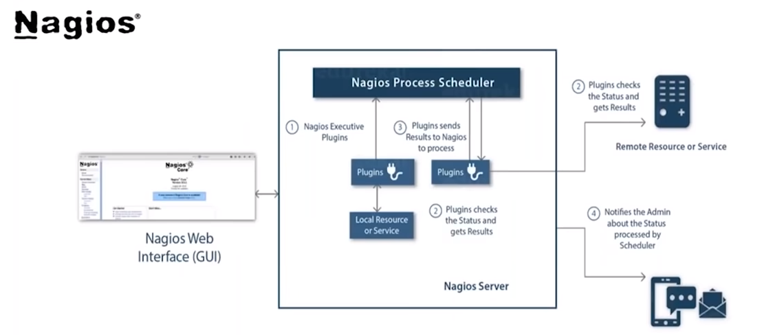
Continuous Monitoring

Slide 87

Nine Pillars of DevOps
Value Stream Management
Application Release Automation
Continuous Delivery CI/CD Pipeline
Leadership
Collaborative Culture
Design for DevOps
Continuous Integration
Continuous Testing
Elastic Infrastructure
Continuous Monitoring
Continuous Security
Continuous Delivery
Orchestration and Automation
Governance

Slide 88
Continuous everything culture in DevOps
Continuous Integration
Code
Build
Continuous Delivery
Test
Release
Continuous Deployment
Test
Release
Deploy
Continuous Monitoring
Operate
Monitor
Plan

Slide 89
DevOps Case Study

Slide 90

DevOps Use Case

Slide 91
Deloitte – Case Study
Deloitte established an end-to-end CI/CD pipeline based on DevOps practices for a major P&C insurer in a green field environment
Pipeline Overview
It used to be agile approach with multiple scrum teams in a synchronized 4-week sprint cycle
The current pipeline is supporting ~ 15 teams with around 100 on-demand, integrated dev/test environments to enable high velocity for the Development and the QA team (~150 deployments daily into dev/ test environments)
Development and QA teams can initiate their own integrated environment builds across the technology “stack” i.e., infrastructure to configuration
Successful builds of a dev/test environment are completed ~ 30 mins with a high success rate
Pipeline is being maintained and supported by a small team (approx. 5) for the entire program
Automated testing includes staged sanity and a nightly regression suite of over 1000 test cases
Small production releases take place on weekly basis with bigger releases going in monthly

Slide 92

Deloitte – Case Study

Slide 93

Deloitte – Case Study

